Slide 1
Deep learning and Social Media in Aim to Cryptocurrency trading

Slide 2

“Can day-trading in cryptocurrency (Bitcoin) markets be better assessed through a deep learning approach that includes, among others, social media data?”
Sergio Villalobos
Academic Work Project

Slide 3

Why Bitcoin as trading instrument?
Global trading 24/7
High Volatility
“Network Effect”
More affordable than traditional financial instruments

Slide 4

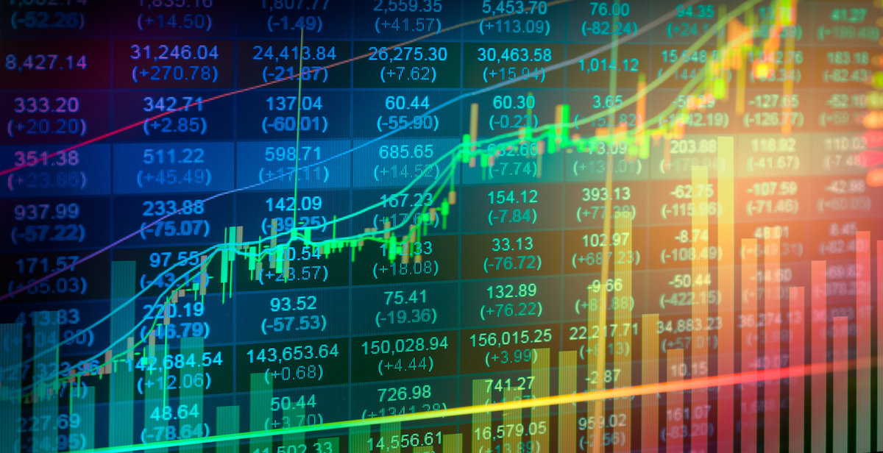

Why Deep Learning, in particular LSTM?
Traditional time series methods are effective only when the series is stationary
Capable of learning long-term dependencies
Model of the non-linearly relationships, stable against price volatility

Slide 5







Feature Categories:
MACD
RSI
Technical Analysis Indicators
Social Media
TRIX
Datasets
Transfers Sum & Avg.
Common Market Indicators
Fundamental* Blockchain Metrics
Volumes
NVT Signal
Closing Price
Active Addresses

Slide 6
Data Process:
Gathering & Pre-processing
Build & Tune LTSM Models
Evaluate Forecasts

Slide 7
Gathering and Preprocess:
DATA GATHERING
CryptoDataDownload.com and BitcoinCharts.com (Market indicators)
Kaggle
GetOldTweets API Pytrends API (Social media)
Coinmetrics.com ( Fundamental daily metrics)
TA-Lib (Technical analysis)
DATA PREPROCESSING
Missing Values: Tweets – Deleted Google trends – Imputed applying spline interpolation
Ranking: Correlation coefficient Maximal Information Coefficient (MIC)

Slide 8
17.737.519 + 4.770.070= 22.507.589
18.757 hours, 11 features
2 Different LTSM approaches
Kaggle DB Tweets + Collected Tweets
Total Set

Slide 9
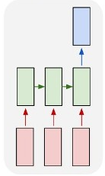
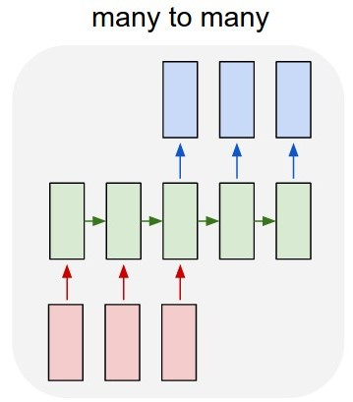
Build & Tune LSTM Models:
Sequence to Vector Prediction:
Sequence to Sequence Prediction:
Many to One Model
Stacked LSTM Layers Architecture
Output Layer = 12 Neurons
Tuning:
Batch size
Number of neurons
Drop out
Many To Many Model
Encoder-Decoder Architecture
Output Layer = 1 Neuron
Tuning:
Batch size
Number of neurons in hidden layers

Slide 10
Average MAPE results:

Slide 11
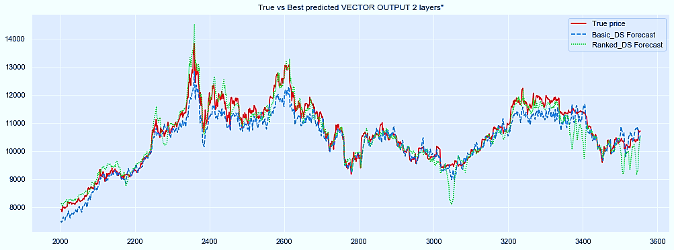
2 Stacked Layers Forecast:

Slide 12
Conclusions:
YES! It is possible to assess better day-trading decisions with models integrating other types of data.
Best mix: social media and fundamental metrics from the blockchain
More robust and more accurate models than the ones using the typical market indicators
There is not sufficient evidence to determine which configuration of LSTM (Seq2Vec or Seq2Seq) is better

Slide 13
Thanks!
Any questions,suggestions?
Contact me on https://www.linkedin.com/in/sergioiv20x/

